Slide 1
Software Engineering I
Dr. Elham Mahmoudzadeh
Isfahan University of Technology
mahmoudzadeh@iut.ac.ir
2021

Slide 2
Chapter 7 Moving To Design(II)

Slide 3
Steps(I)
Preparing proposal
Requirements determination
User story
Abstract Business Process Modelling
Analysis
Functional Modelling
Structural Modelling
Behavioral Modelling

Slide 4
Steps(II)
Design
Optimization
Database Management
User Interface
Physical Architecture

Slide 5
The purpose of analysis is to figure out what the business needs are. The purpose of design is to decide how to build the system.

Slide 6
Layers
Until this point in the development of our system, we have focused only on the problem domain; we have totally ignored the system environment (data management, user interface, and physical architecture).
To successfully evolve the analysis model of the system into a design model of the system, we must add the system environment information.
One useful way to do this, is to use layers.
A layer represents an element of the software architecture of the evolving system.
There should be a layer for each of the different elements of the system environment (e.g., data management, user interface, physical architecture).

Slide 7
Layers(Cnt’d)
The idea of separating the different elements of the architecture into separate layers can be traced back to the MVC architecture of Smalltalk.
Separate the application logic from the logic of the user interface. In this manner, it was possible to easily develop different user interfaces that worked with the same application.

Slide 8
Software layers
Foundation,
Problem domain,
Data management,
Human–computer interaction,
Physical architecture

Slide 9
Foundation Layer
Is a very uninteresting layer.
It contains classes that are necessary for any object-oriented application to exist.
They include classes that represent fundamental data types (e.g., integers, real numbers, characters, strings), classes that represent fundamental data structures, sometimes referred to as container classes (e.g., lists, trees, graphs, sets, stacks, queues), and classes that represent useful abstractions, sometimes referred to as utility classes (e.g., date, time, money).
These classes are rarely, if ever, modified by a developer. They are simply used.
Today, the classes found on this layer are typically included with the object-oriented development environments.

Slide 10
Problem Domain Layer
Is what we have focused our attention on up until now.
At this stage in the development of our system, we need to further detail the classes so that we can implement them in an effective and efficient manner.

Slide 11
Data Management Layer
Addresses the issues involving the persistence of the objects contained in the system.
The types of classes that appear in this layer deal with how objects can be stored and retrieved.
Classes contained in this layer are called the Data Access and Manipulation (DAM) classes.
Allow the problem domain classes to be independent of the storage used and, hence, increase the portability of the evolving system.
Some of the issues related to this layer include choice of the storage format and optimization.

Slide 12
Human–Computer Interaction Layer
The primary purpose is to keep the specific user-interface implementation separate from the problem domain classes.
This increases the portability of the evolving system.
Typical classes found on this layer include classes that can be used to represent buttons, windows, text fields, scroll bars, check boxes, drop-down lists, and many other classes that represent user-interface elements.

Slide 13
Physical Architecture Layer
Addresses how the software will execute on specific computers and networks.
This layer includes classes that deal with communication between the software and the computer’s operating system and the network.

Slide 14
Packages
In UML, collaborations, partitions, and layers can be represented by a higher-level construct: a package.
In fact, a package serves the same purpose as a folder on your computer.
A package is a general construct that can be applied to any of the elements in UML models, group of use cases together to make the use-case diagrams easier to read and to keep the models at a reasonable level of complexity or a set of class and communication diagrams.

Slide 15
Package Diagrams
A diagram composed only of packages.
In a package diagram, it is useful to depict dependency relationship.
Dependency relationship represents the fact that a modification dependency exists between two packages. That is, it is possible that a change in one package could cause a change to be required in another package.

Slide 16
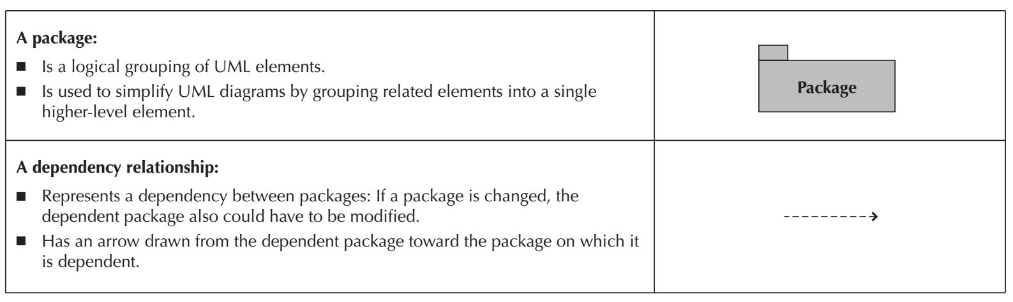
Elements of a package diagram

Slide 17
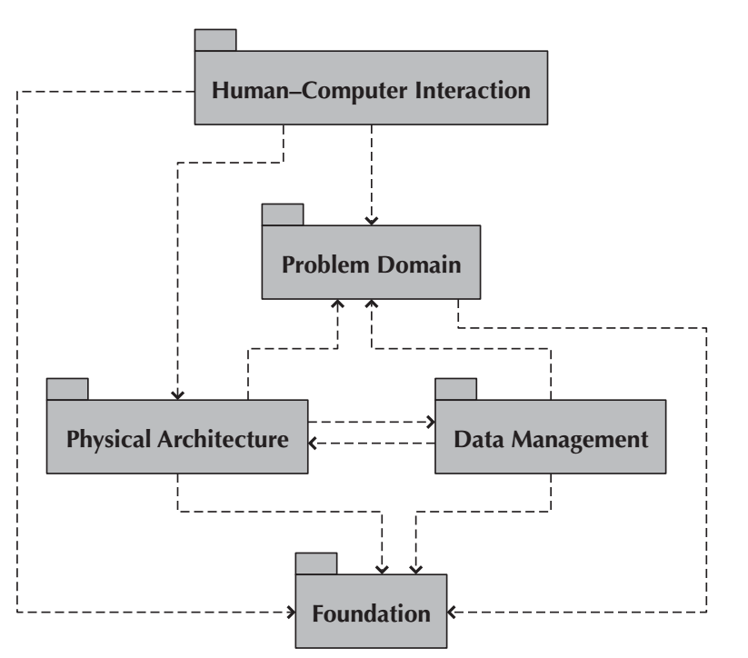
Package Diagram of Dependency Relationships among Layers

Slide 18
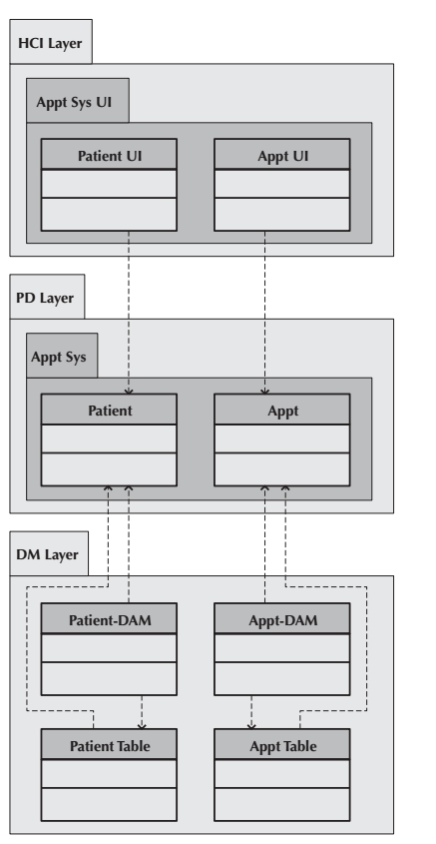
An example of package diagram

Slide 19
Verifying and validating package diagram
Like all the previous models, package diagrams need to be verified and validated.
First, the identified packages must make sense from a problem domain point of view.
Second, all dependency relationships must be based on message-sending relationships on the communications diagram, and associations on the class diagram.

Slide 20
Design Strategies
Custom Development
Packaged Software
Outsourcing

Slide 21
Custom development or building a new system from scratch,
Teams have complete control over the way the system looks and functions.
Allows developers to be flexible and creative in the way they solve business problems.
Is easier to change to include components that take advantage of current technologies that can support such strategic efforts.
Building a system in-house also builds technical skills and functional knowledge within the company.
As developers work with business users, their understanding of the business grows and they become better able to align IS with strategies and needs.
These same developers climb the technology learning curve so that future projects applying similar technology require much less effort.

Slide 22
Custom development or building a new system from scratch(Cnt’d)
Requires dedicated effort that involves long hours and hard work. Many companies have a development staff who already is overcommitted to filling huge backlogs of systems requests and just does not have time for another project. Also, a variety of skills—technical, interpersonal, functional, project management, and modeling—must be in place for the project to move ahead smoothly.
The risks associated with building a system from the ground up can be quite high, and there is no guarantee that the project will succeed.
Developers could be pulled away to work on other projects, technical obstacles could cause unexpected delays, and the business users could become impatient with a growing timeline.

Slide 23
Packaged Software
There are thousands of commercially available software programs that have already been written to serve a multitude of purposes.
Similarly, most companies have needs that can be met quite well by packaged software, such as payroll or accounts receivable. It can be much more efficient to buy programs that have already been created, tested, and proven.
Moreover, a packaged system can be bought and installed in a relatively short time when compared with a custom system. Plus, packaged systems incorporate the expertise and experience of the vendor who created the software.

Slide 24
Packaged Software(Cnt’d)
Most packaged applications allow customization, or the manipulation of system parameters to change the way certain features work.
Systems integration refers to the process of building new systems by combining packaged software, existing legacy systems, and new software written to integrate these.

Slide 25
Outsourcing
Hire an external vendor, developer, or service provider to create the system.
This transfer requires two-way coordination, exchange of information, and trust.

Slide 26
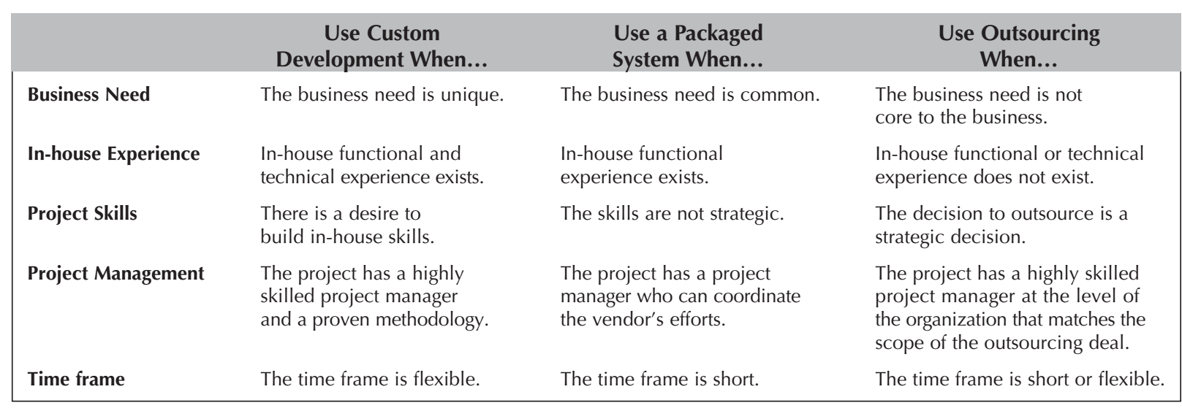
Selecting a Design Strategy

Slide 27
Reference
Dennis, Wixon, Tegarden, “System Analysis and Design, An Object Oriented Approach with UML”, 5th Edition, 2015.

